Slide 1

Social Media 101
The basics

Slide 2
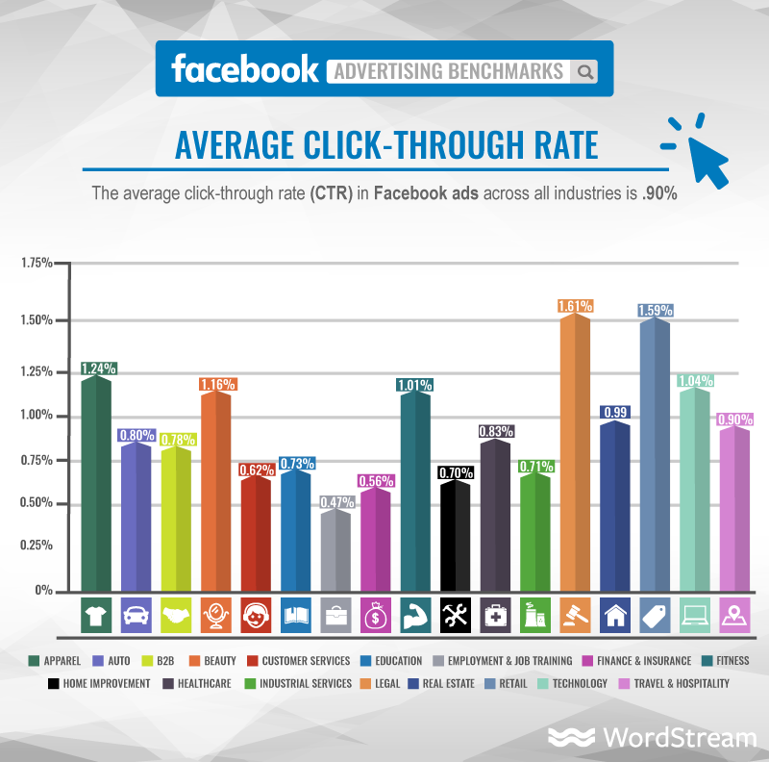
Finance ads 0.56%
Real Estate ads 0.99%

Slide 4
“Market like the year you are in!”
- Gary Vaynerchuck

Slide 5

Pre Covid 19 Real Estate Business

Slide 6
“Don’t find customers for your products, find products for your customers.”
- Seth Godin

Slide 7

Your Options/ Channels

Slide 8

Your Audience
Persona
Location
Niche
Exclusions

Slide 9

Getting the word out
Localised content
Repurpose
Cost Management

Slide 10

Bait, Hook and Reel In
Website
Lead Generation tool
Retarget

Slide 11

Be Realist
Spreading yourself to thin
Time

Slide 12
“Help your customers and you help your business.”
- Leo Burnett

